Slide 1
BlinkDB: Queries with Bounded Error and Bounded Response Times on Very Large Data Sameer Agarwal, Barzan Mozafari, Aurojit Panda, Henry Milner, Samuel Madden, Ion Stoica
Presented By
Subham De

Slide 2

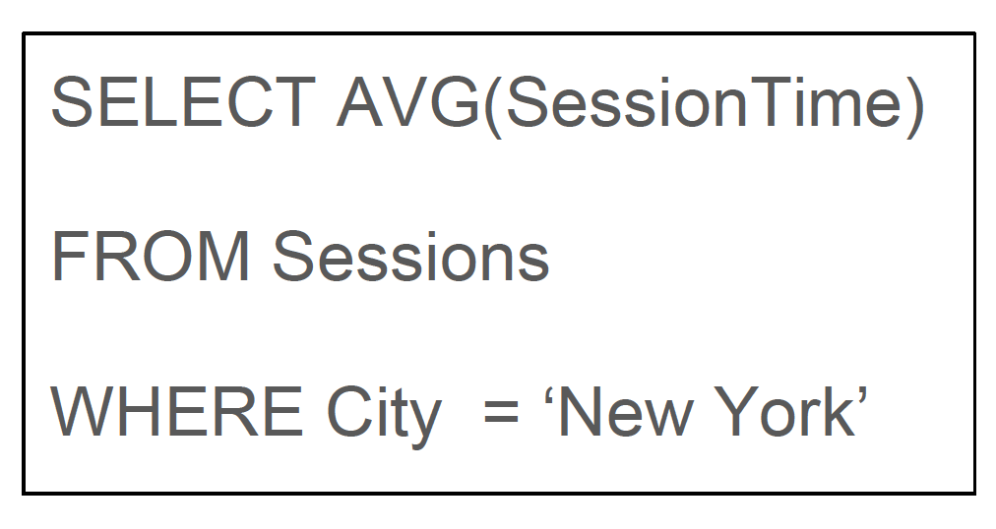
Motivation: Huge Data & Real-Time Response
Multiple dimensions of data
Aggregate Queries over large number of records
Sessions :
100 million tuples for ‘New York’
High cost in execution time
UsedID | City | Age | SessionTime

Slide 3
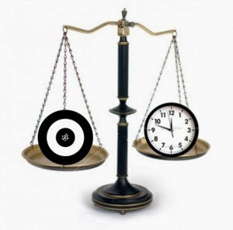

Main Idea
Trade Off : Accuracy vs Latency
Approximation Techniques
Sampling
Sketches
Online Aggregation
BlinkDB

Slide 4

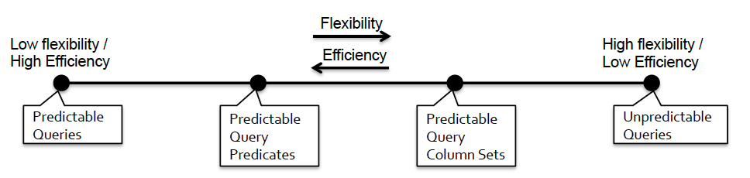
Creating Samples
Future Query Workload Prediction
Assumptions on future workload model
All Queries
known
Query Group &
Filter Predicates
Frequency
Query Column Sets
For Group & Filter
Predicates Frequency
No Queries
known
[Sampling/Sketches]
[BlinkDB]
[Online Aggregation]

Slide 5
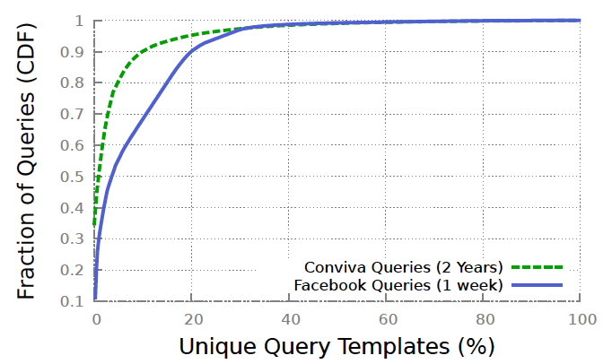
BlinkDB Workload Model
SELECT AVG(Session Time)
FROM Sessions
WHERE City=‘NEW YORK’
SELECT AVG(Session Time)
FROM Sessions
WHERE City=‘GALENA,IL’
BlinkDB
Sampling/Sketches |  | Cannot Answer (No Sample)
Online Aggregation |  | Inefficient
BlinkDB : Stable Column Set for
ALL Queries

Slide 6
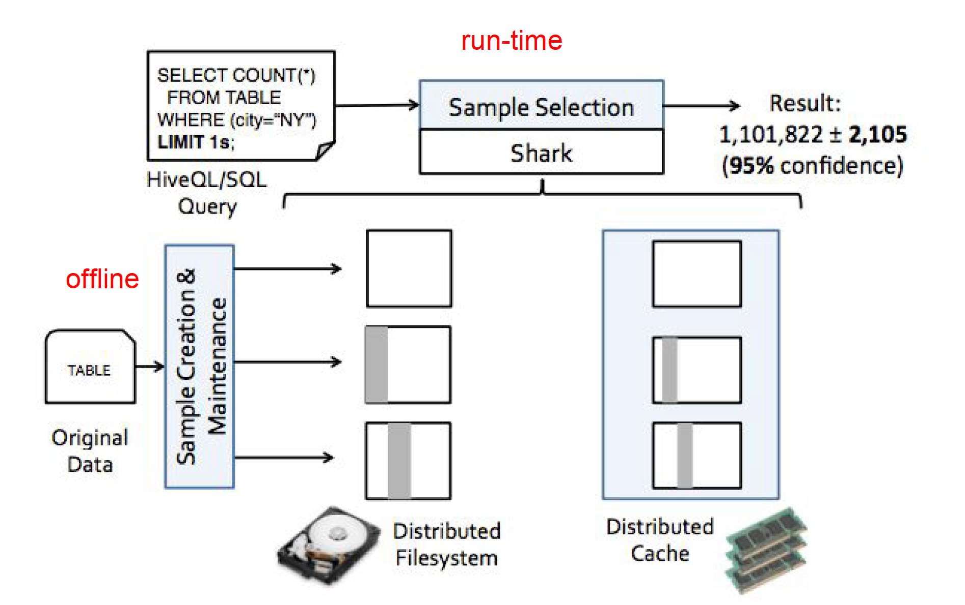
BlinkDB Architecture

Slide 7
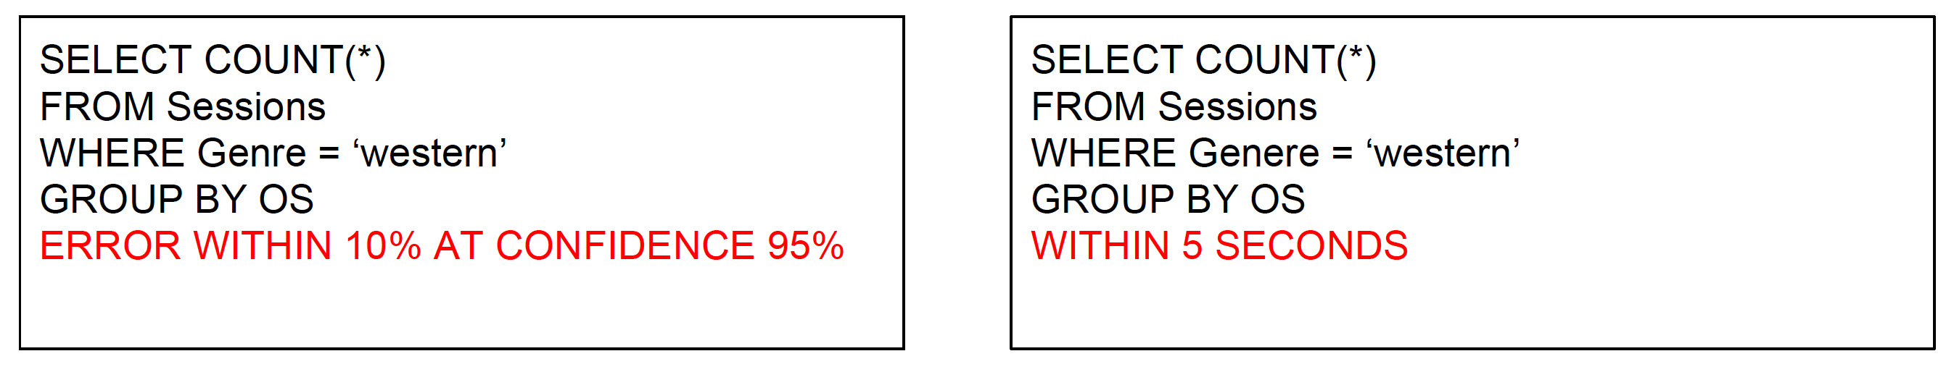
BlinkDB Query Model
Sessions :
SessionID | Genre | OS | City | URL
Constraint in respect of Error or Time

Slide 8
Sample Creation
Uniform vs Stratified Sampling
Query Column Set(QCS) = [‘City’ ]
UserID | City | Age | SessionTime
1 | New York | 25 | 234
2 | Galena,IL | 34 | 432
3 | New York | 33 | 456
4 | New York | 32 | 574
UserID | City | Age | Session Time
1 | New York | 25 | 234
3 | New York | 33 | 456
Uniform Sampling
= 1/2
Galena,IL missed

Slide 9
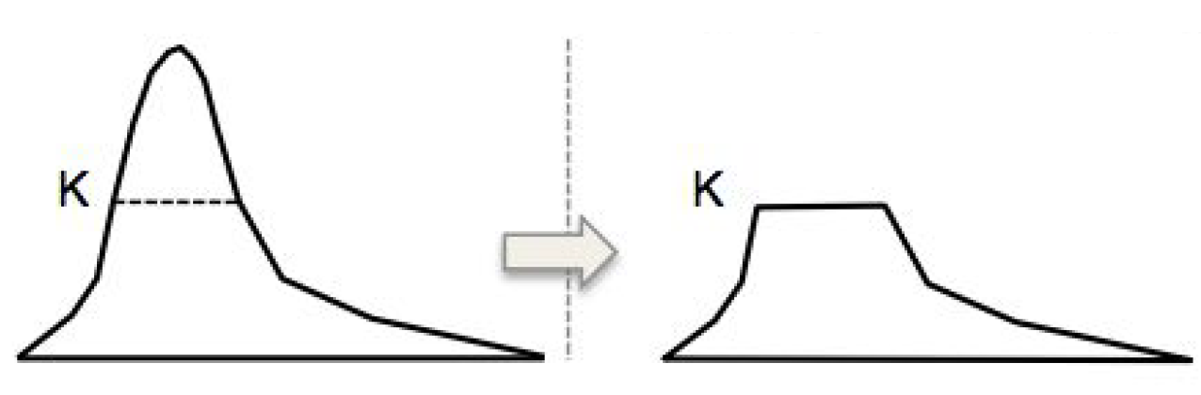
Stratified Sampling
Assign equal sample size(K) to each unique value in QCS
UserID | City | Age | SessionTime
1 | New York | 25 | 234
2 | Galena,IL | 34 | 432
3 | New York | 33 | 456
4 | New York | 32 | 574
UserID | City | Age | Session Time
1 | New York | 25 | 234
2 | Galena, IL | 34 | 432
Stratified Sampling
K = 1

Slide 10
Stratified Sampling Strategies
Multiple single dimensional samples
Too many samples.
Inefficiently answer queries with multiple columns
Single multi-dimensional sample
Too many unique values
Storage overhead huge
BlinkDB : several multi-dimensional samples
[City], [Age], [City,Age], [City,SessionTime]…. many possibilities
N Columns -> 2^N possible stratified samples
Optimize subset selection

Slide 11
Optimization Factors
Sparsity : Select column subset that has many rare tuples.
Otherwise, Uniform better
COUNT(Distinct_Value) WHERE Freq(Distinct_Value) <= Threshold
Workload : Choose Column subset that occurs more in past query
Normalized (Query Count containing target subset)
Storage Cost : Restrict total size of all samples to some constraint, C

Slide 12
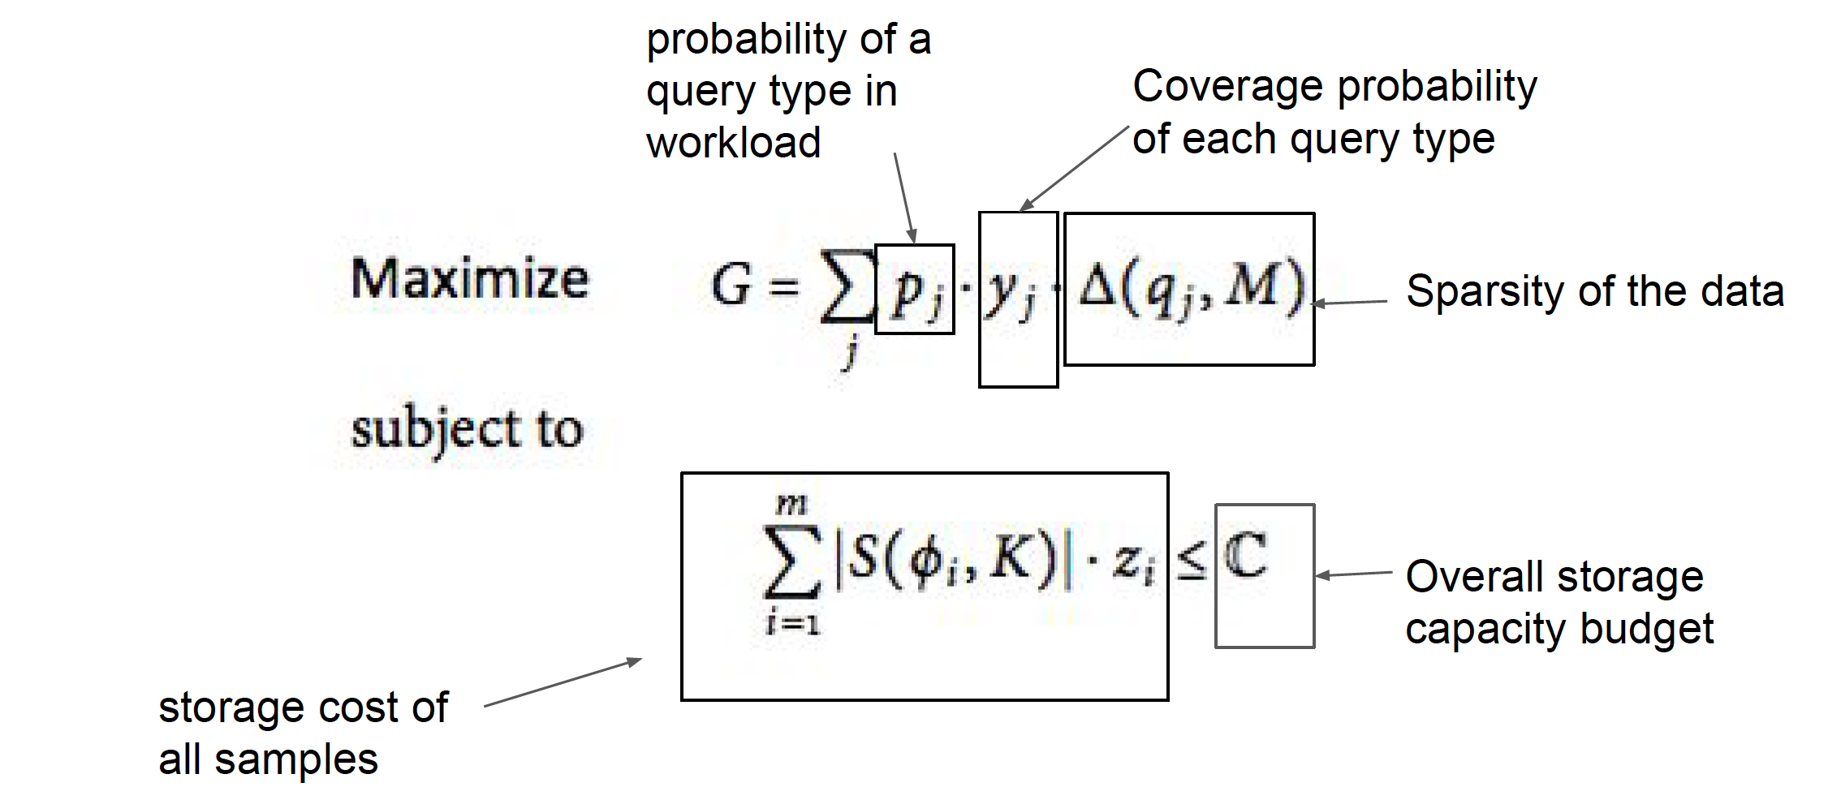
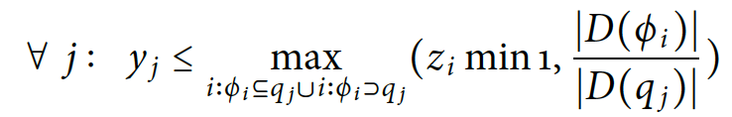
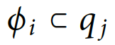
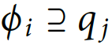
Optimization Formulation
Boolean variable on subset selection
Partial coverage,
Total coverage,

Slide 13
Sample Selection
Select best sample that satisfies error/time constraints
Select best fitted sample
1. Sample with smallest column superset of current query
[Full Coverage]
2. Sample with column subset of current query and Highly selective
[Partial Coverage]
Selectivity = ( Number of rows selected by Q ) / (Number of rows in sample)

Slide 14
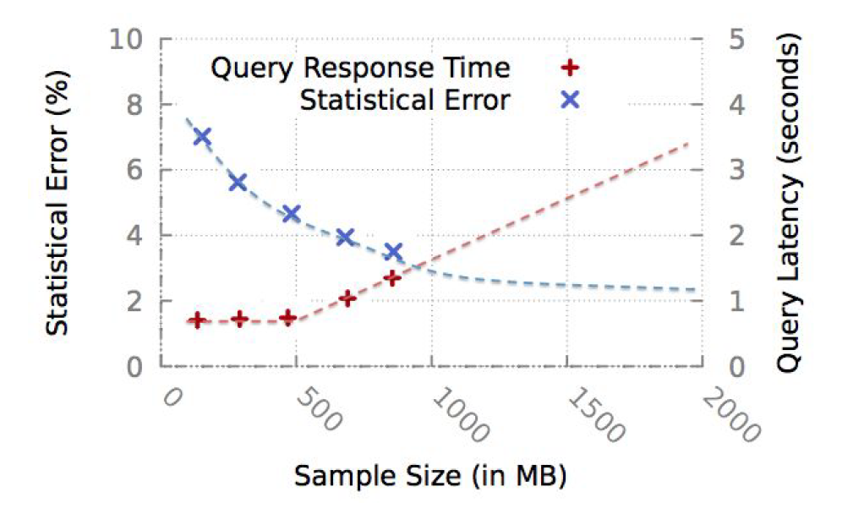
Subsample selection - ELP
Select appropriate size of subsample from best sample
Construct Error Latency Profile(ELP)
Run query on small subsample and extrapolate on time & error
Gather statistics on
Selectivity
Underlying Data Distribution
Complexity

Slide 15
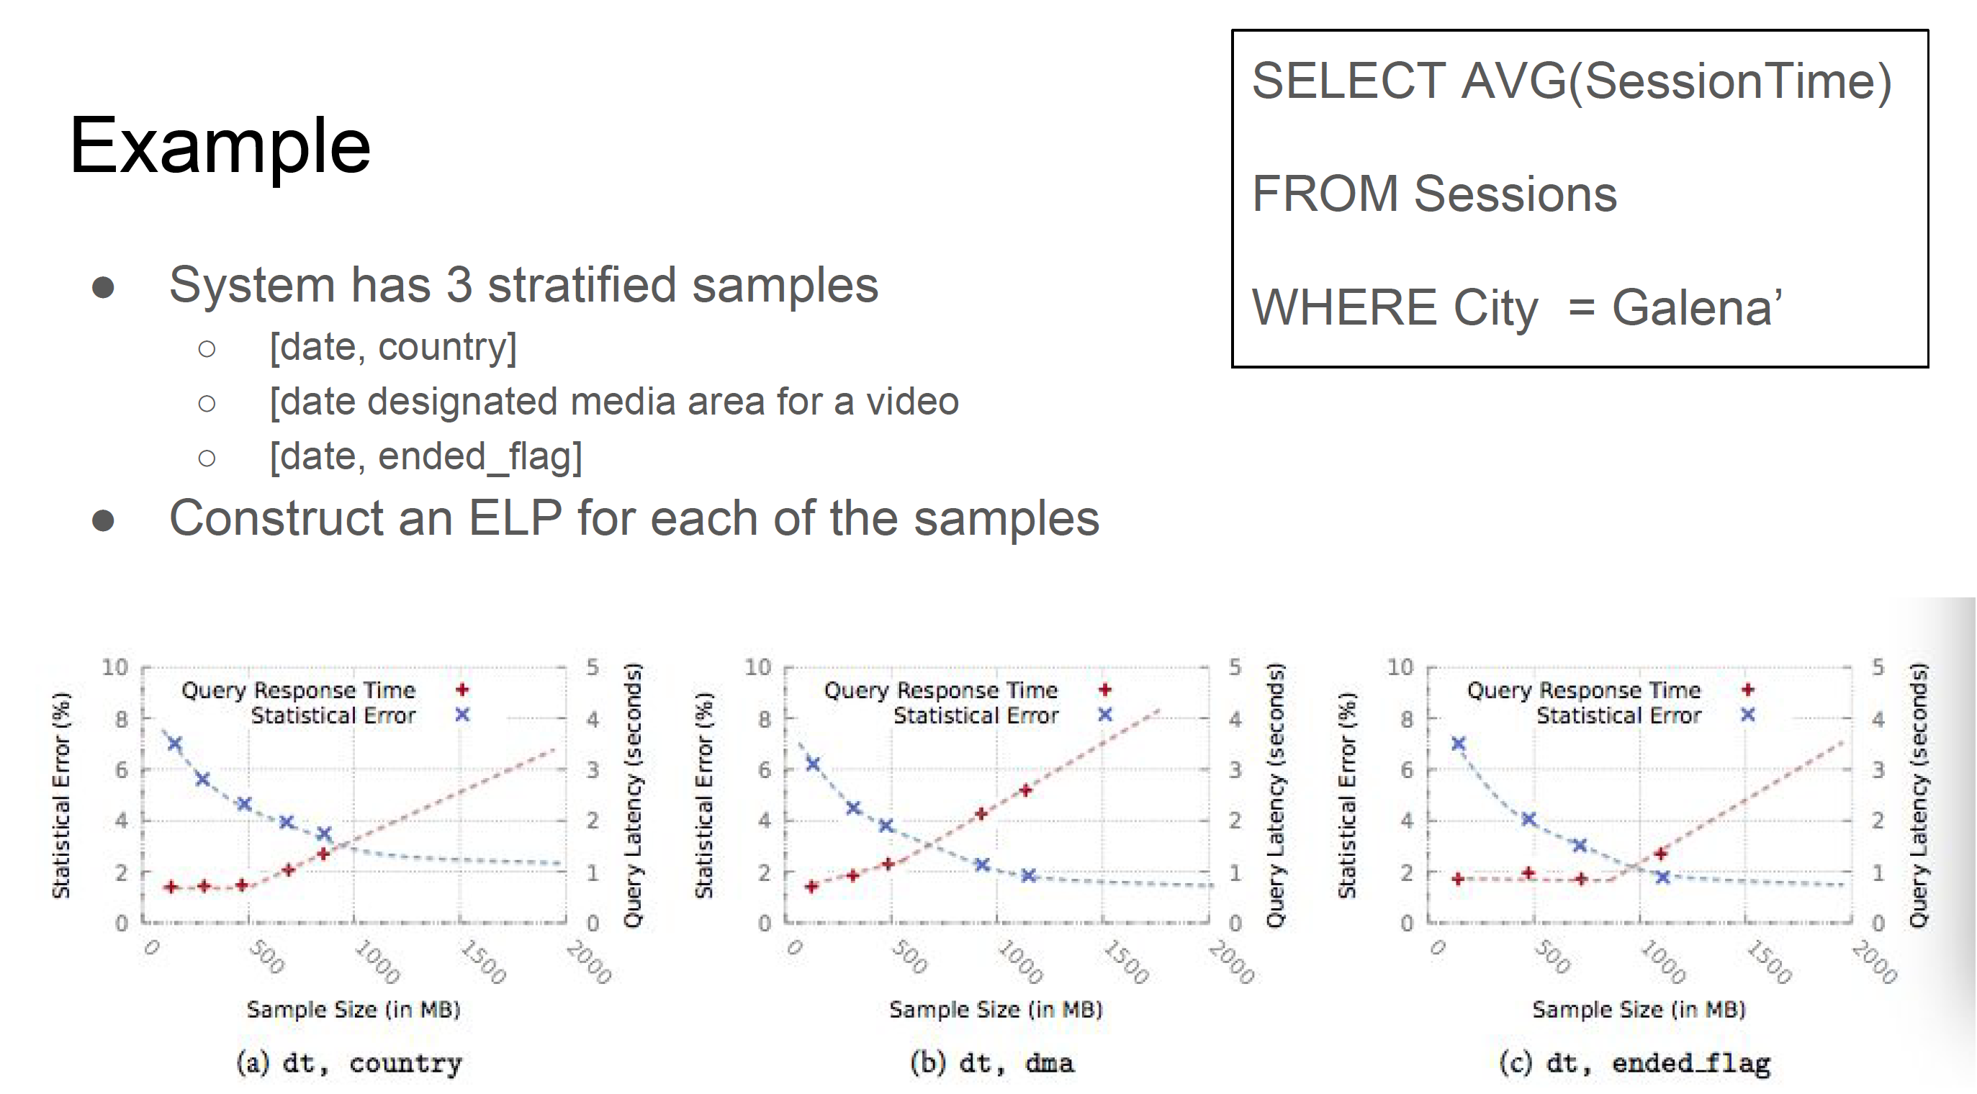
Query Response Time Lower

Slide 16
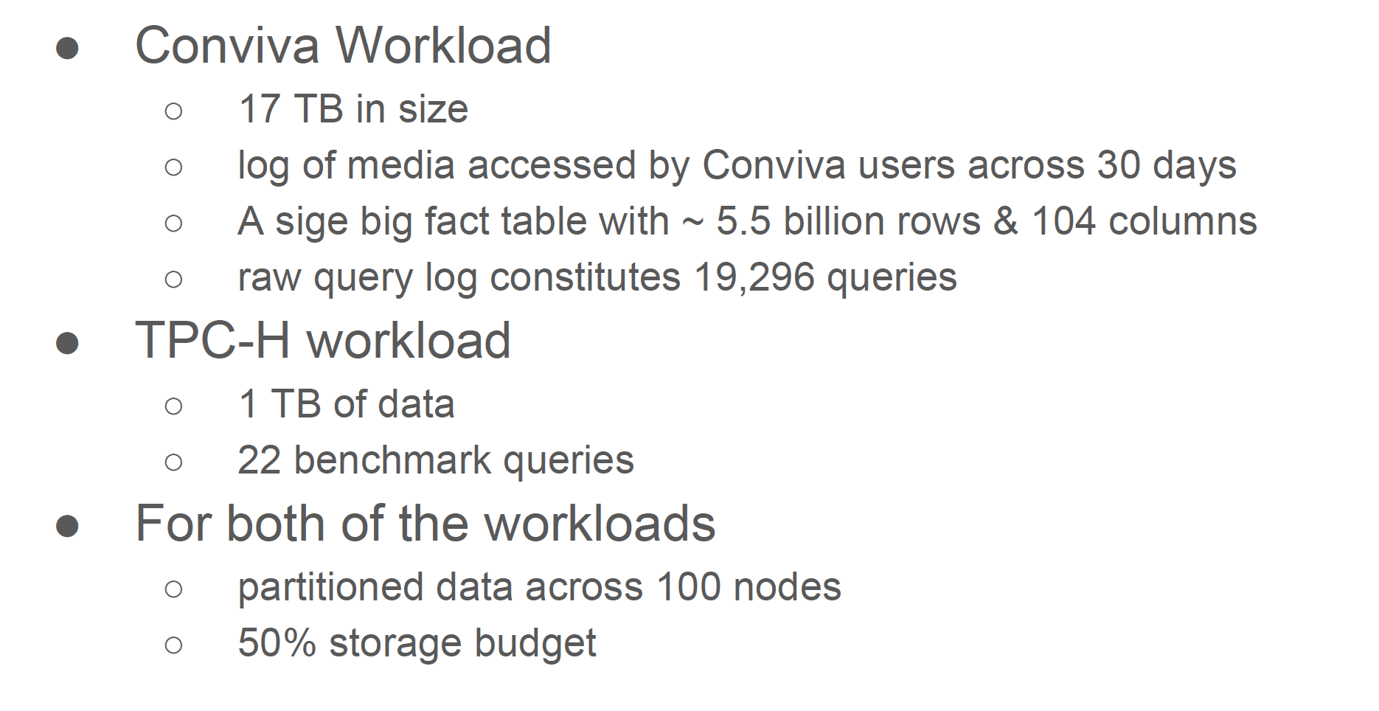
Evaluation

Slide 17
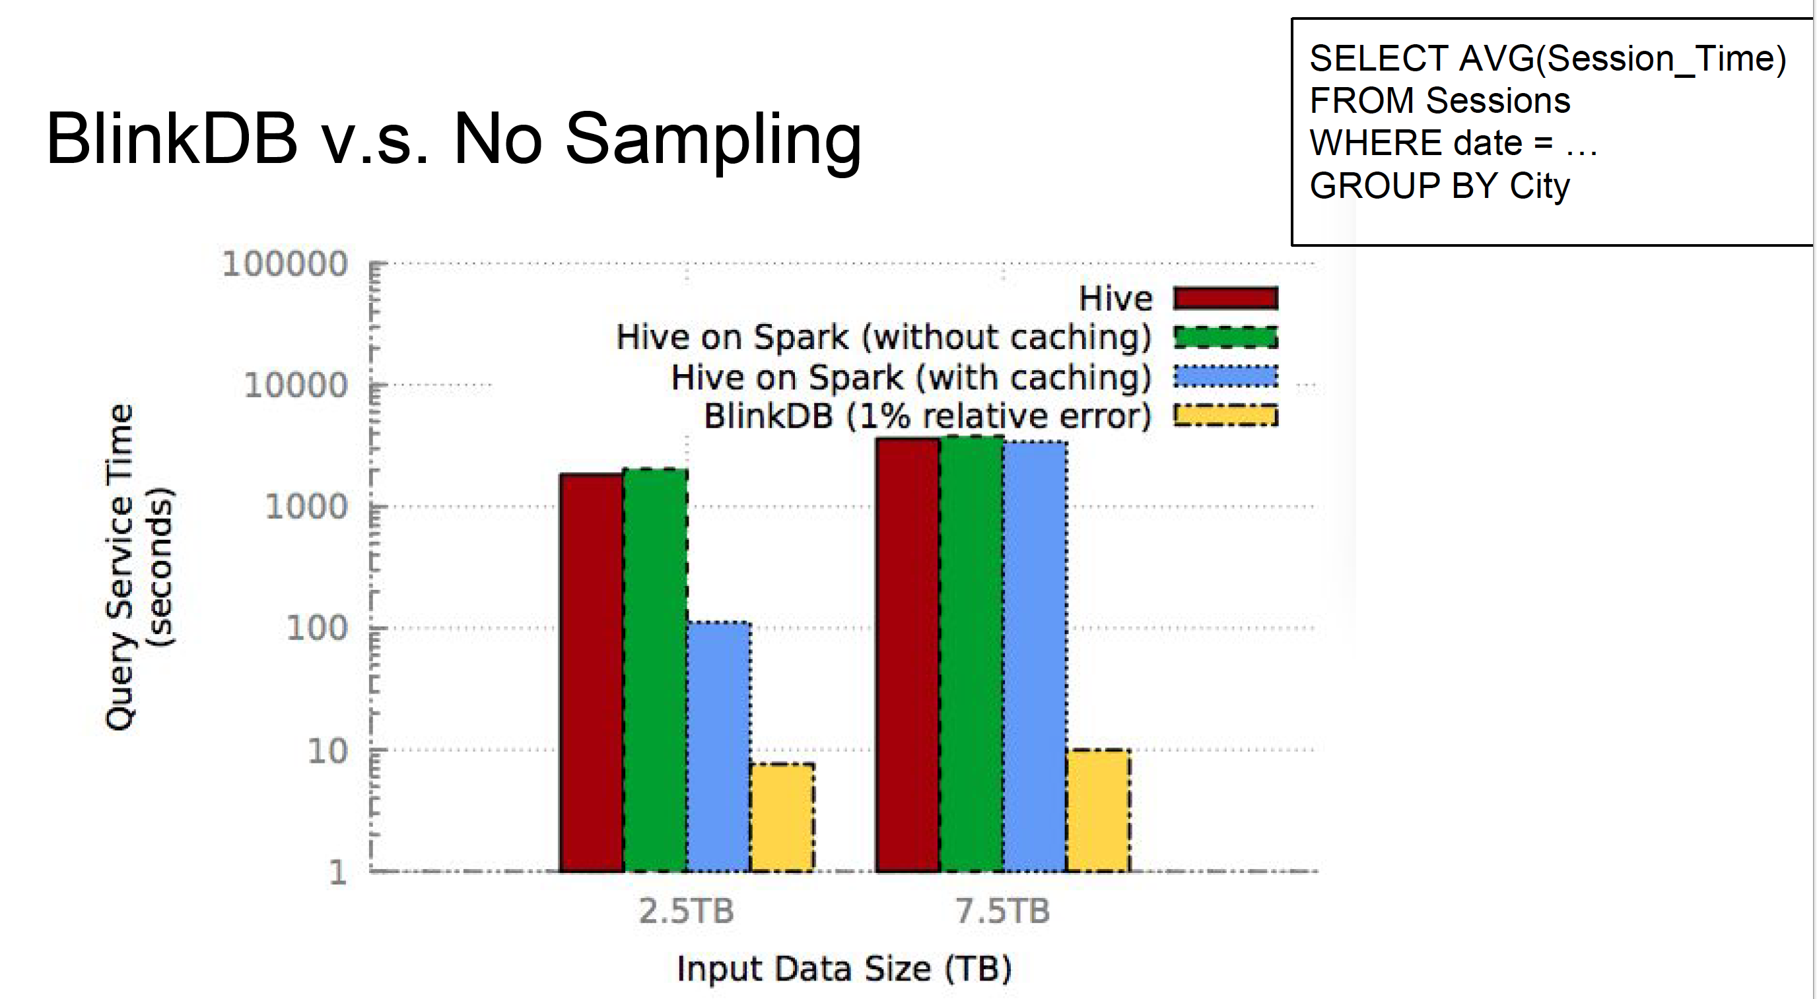

Slide 18
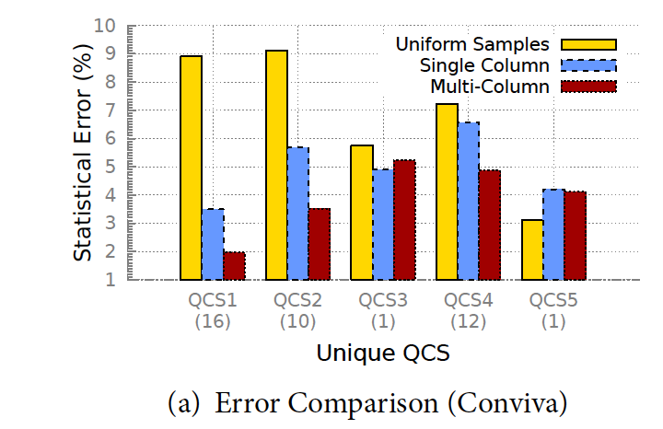
Error Properties with Different Samples
All samples of same size
Queries run for max 10s
BlinkDB samples on QCS1, QCS2

Slide 19
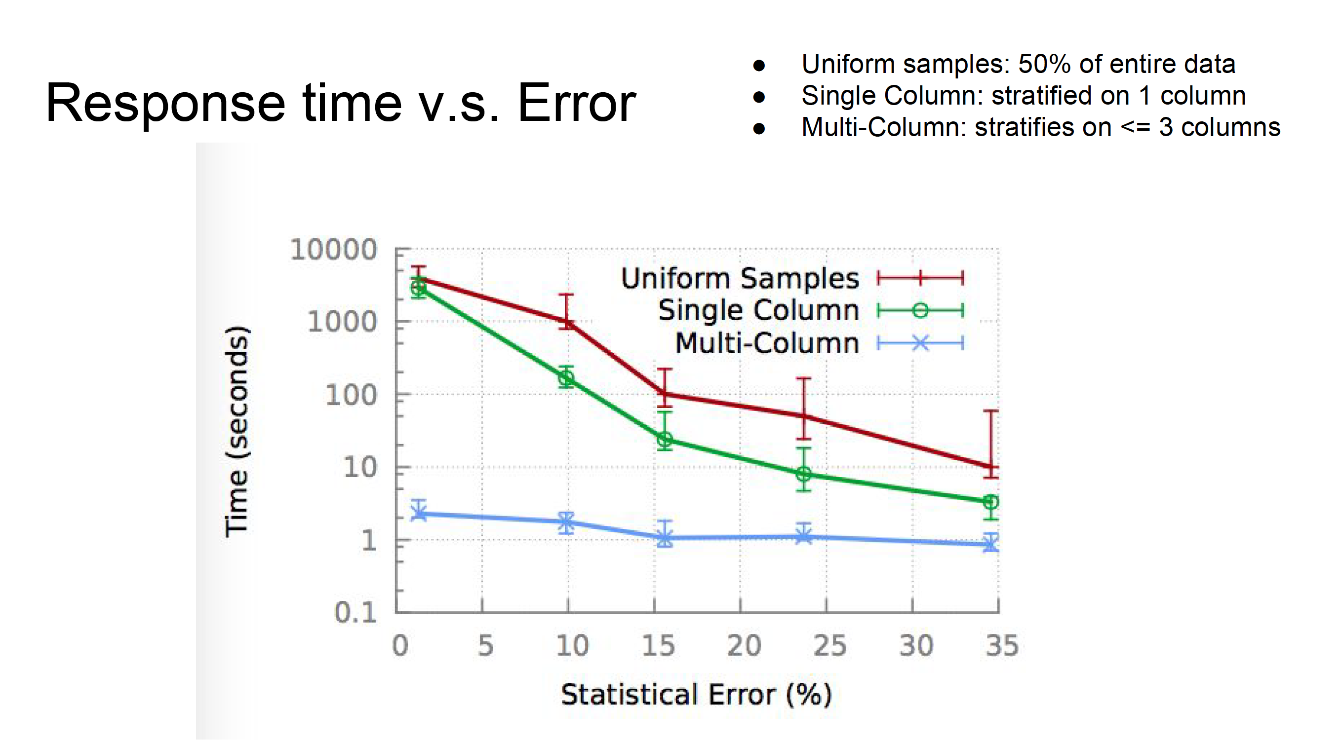

Slide 20
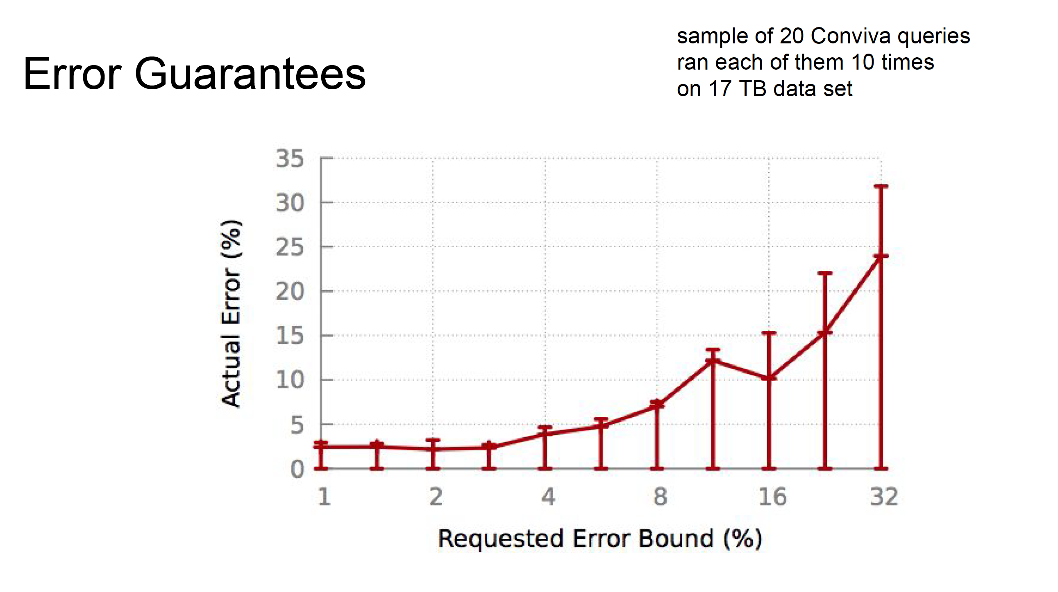

Slide 21
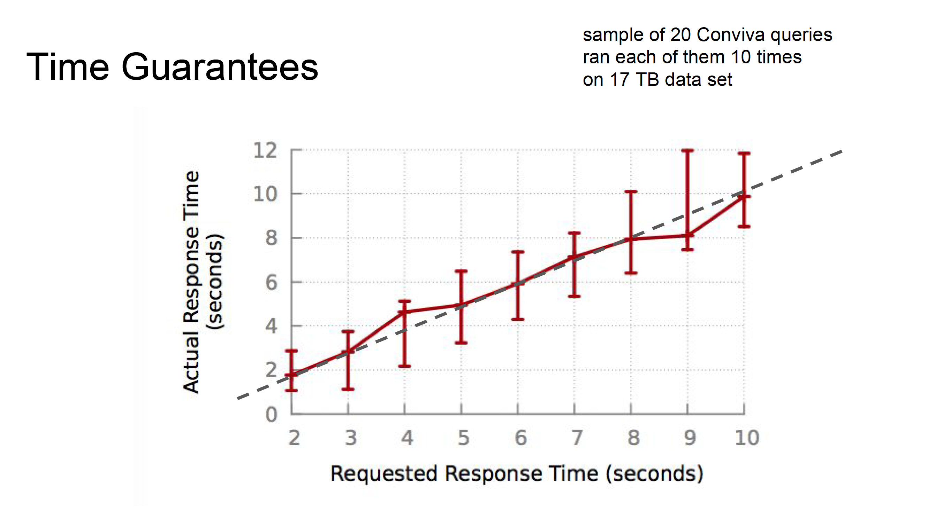

Slide 22
Thank you

